Slide 1

cordillera
a development pipeline for exceptional men
August Larson | Donny.io | Marcus Zuech

Slide 2
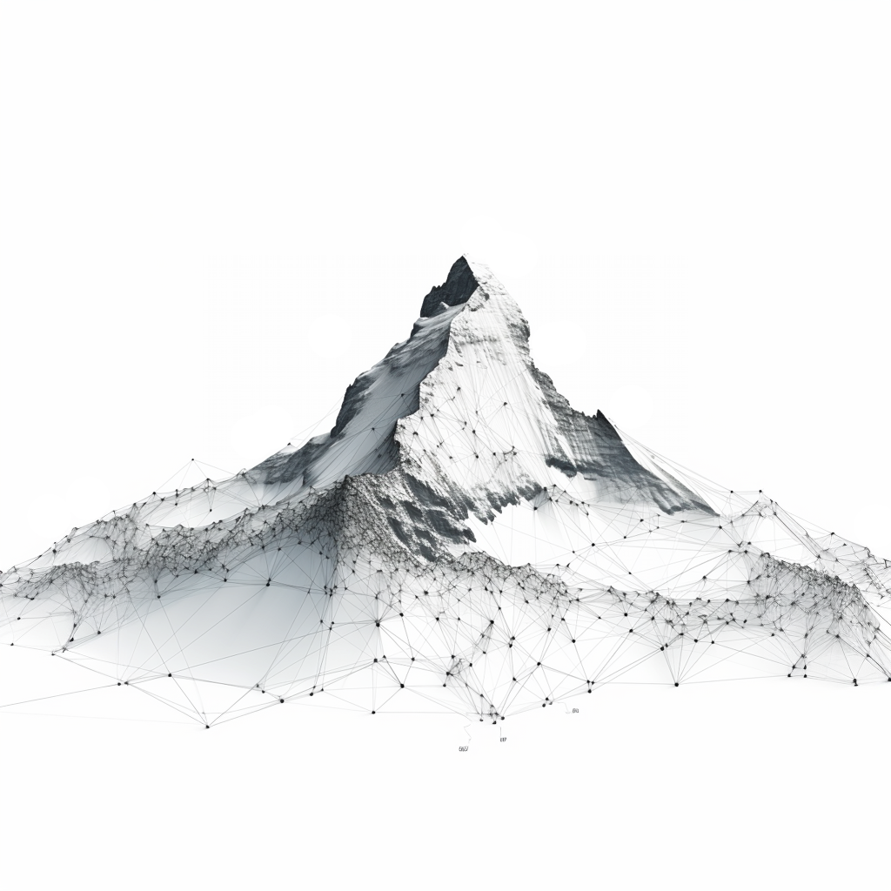
EXIT Scaling Problems:
- Private profile data is limited access
- Single point of matchmaking/introductions
- Limits of meeting-based collaboration
- Schedule conflicts
- Timezone Conflicts
- Splitting meetings means
partitioning members
- Some members may require intensive
mentoring or feedback to develop
their projects & ideas
- Need additional tiers of leadership
to scale beyond Dunbar
constraints
Initial Suggestions:
- Chatbot to automate profile collection
-Does not address scaling chokepoint
-Structured data collection works
better as a webform
- Automated matchmaking/clustering
-Best results come from natural
language samples and graph
analysis

Slide 3
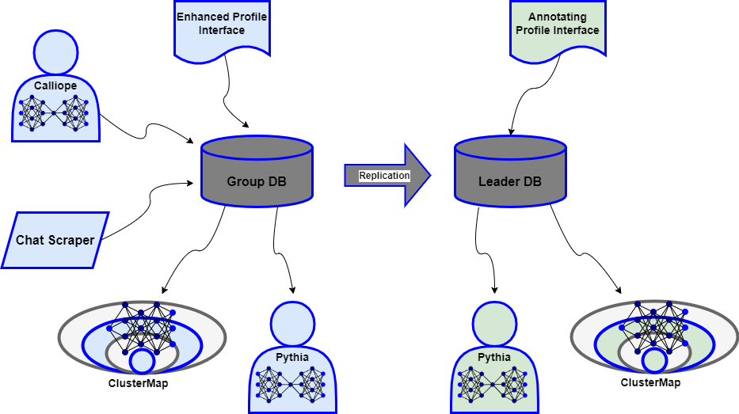
Proposed Solution:

Slide 4
Enhanced Profile Interface
In order to reduce administrative overhead and allow Exit members to more easily keep their data up to date, the Membership Application currently used to collect structured data about new members will be enhanced with new fields and options and connected to a new Exit Membership Database.
This webform will remain accessible through the website for signed-in members to view and edit their previous entries.
In the future, a simple non-AI bot will be deployed to RocketChat to allow members to maintain their profile data from within that app.
Leadership Profile Interface
An extended version of the profile interface will be accessible to Exit senior leadership which will allow the retrieval of a member’s profile by name or ID search and will expose additional annotation and scheduled reminder fields which the leader can use to store additional notes and observations as well as to expand on user-provided fields like skills and interests during screening and check-in interviews.
The Leadership interface will persist changes to a private database instance accessible only to the leader and his private instances of our search and analytic tools.

Slide 5
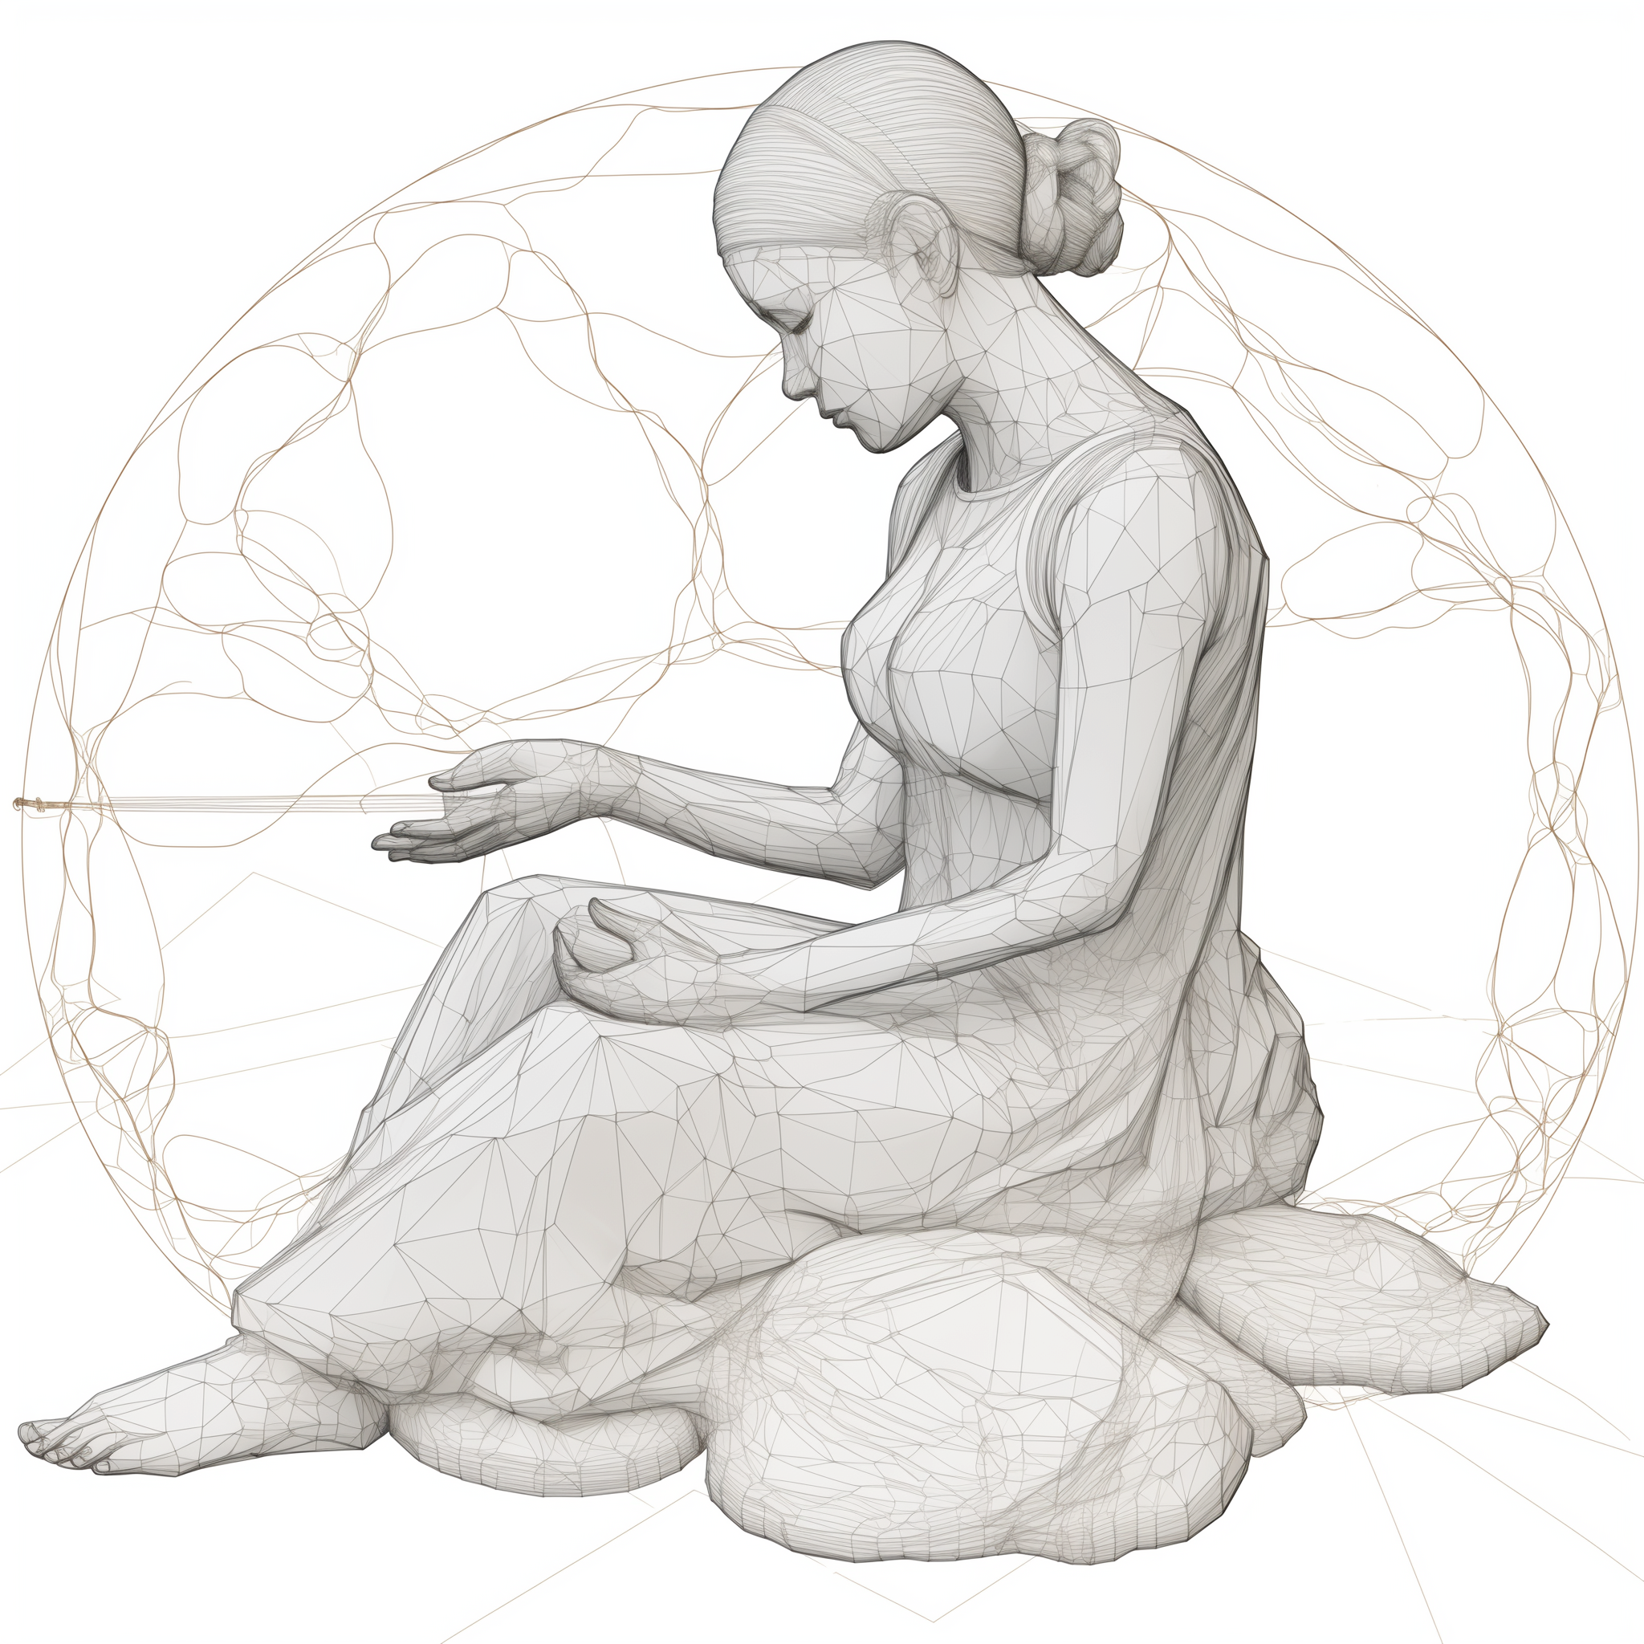
Calliope
Calliope, the muse of epic poetry, is our name for the chatbot assistant we intend to train based on the prototype found in /exitbot_2 in our project repository. Instead of being simply a helpful assistant, Calliope is configured and trained to be a collaborator and conversation partner. Her goal is to prod Exit members to explore their ideas and think through problems as they arise.
Exit members can also use Calliope as they might use ChatGPT or similar commercial chatbot assistants without their queries and chatlogs being visible to potentially untrustworthy companies. In the course of her conversations with members, Calliope builds a text corpus of each member’s conversations which can then be used to identify skills, interests, affinities, and personality profiles of those members. This data along with that collected by Chat Scraper are then available to ClusterMap and Pythia to answer questions about the Exit member base.

Slide 6
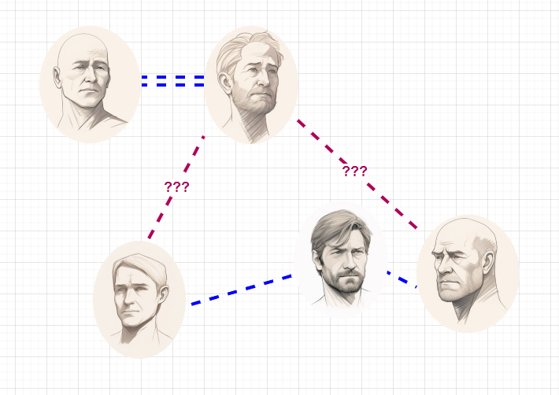
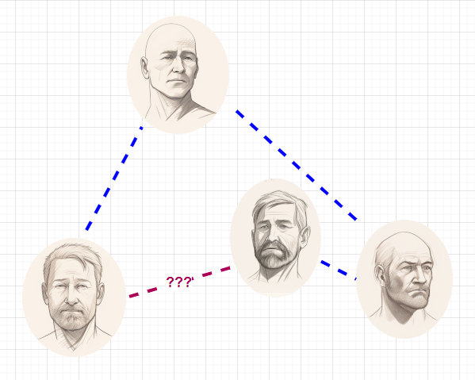
Chat Scraper
A second graph-based model will be built using conversations scraped from the Exit group chats. This model will be aware of member profiles and will attempt to capture relationships and affinities which are apparent through online interactions.
The Chat Scraper model will identify recurring patterns of interactions between members as well as the content of their discussions and will use this information to identify:
- Friendship vs mentorship vs pragmatic collaboration
- Likely topics of interest for a given group - Members likely to have an affinity for one another
- Latent networks within the Exit member base
- Opportunities to connect such networks with one
another through key members
- Abstracted social “templates” to guide future
recruiting, organizing, and programming

Slide 7
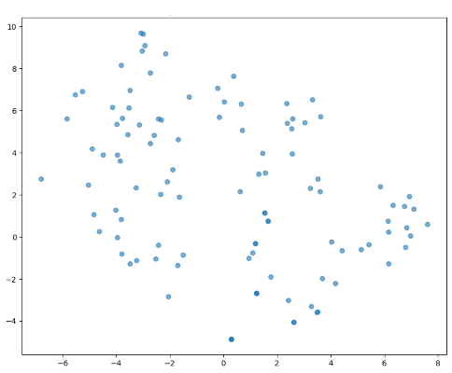
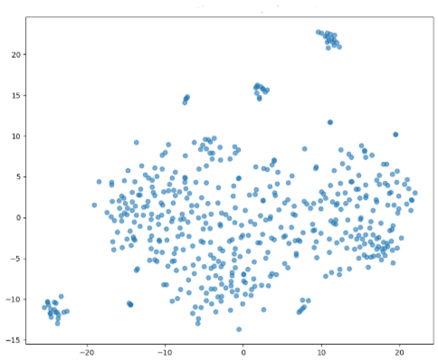
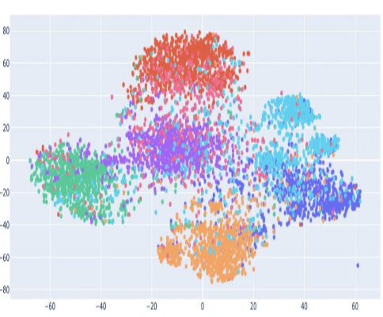
Clustermap
As we have demonstrated in this proof-of-concept project, valuable insights can be derived from the t-SNE clustering of text corpuses and text+structured data datasets.
In our proposed solution, Exit leadership would be able to access a GUI-based tool for querying a multidimentional model of Exit members including their structured profile, Calliope corpus, and chat corpus+chat graph.
This tool can be used to cluster members along any dimension or through an arbitrary text prompt.

Slide 8
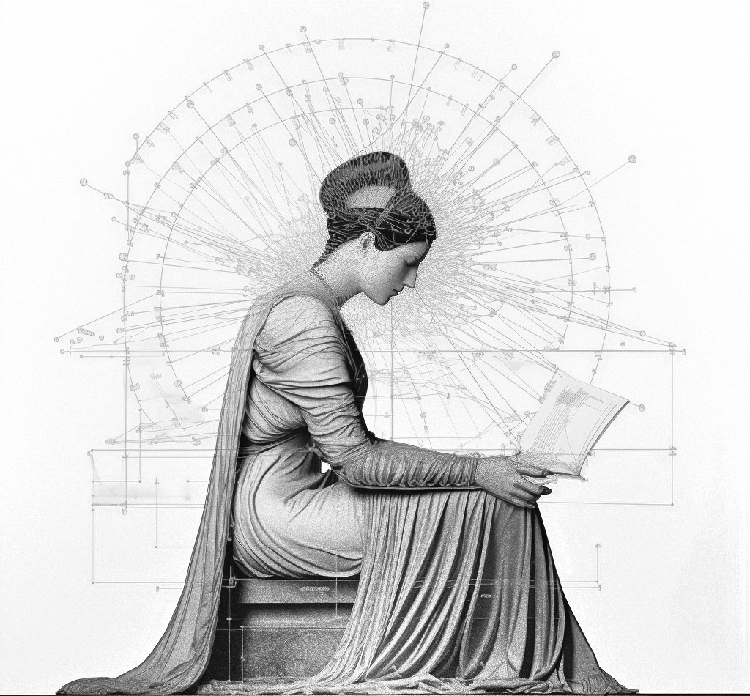
Pythia
Pythia is a Retrieval Augmented Generation (RAG) LLM which will serve as the main search interface to the combined Exit member data environment. Unlike familiar general-purpose chatbots, a RAG generates answers by referencing one or more bodies of authoritative data. As a consequence, RAG responses are far more likely to be topical and accurate and RAGs are less prone to hallucination then general-purpose LLM assistants. Members will be able to access an instance of Pythia which is aware of other members’ public profile data and the Chat Scraper model (since members have access to the Exit RocketChat instance, this will not expose them to private information which would not have been visible to them otherwise). Exit leadership will have access to an instance of Pythia which has access to the full set of Exit member data.

Slide 9

progress so far

Slide 10


Proof-of-Concept Project:
(11/20 - 12/4/2023)
A Partnership of EXIT Group and ShaolinAI
Automated & Semi-Automated data generation
T-SNE clustering model prototype
Locally deployable Mistral7 based Chat Assistant
Locally deployable Mistral7 RAG SearchBot

Slide 11
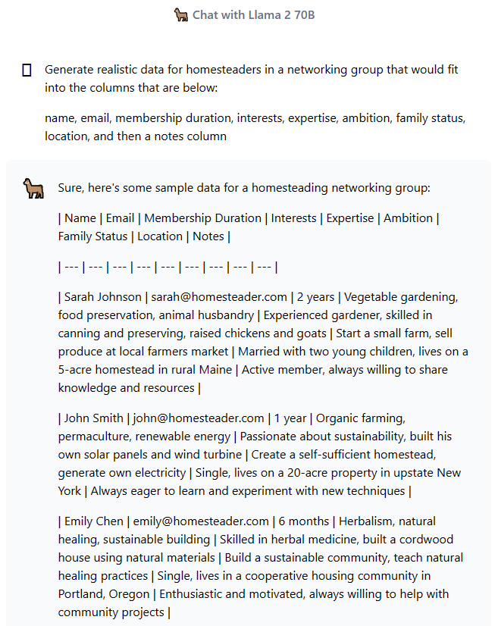
Automated & Semi-Automated data generation
Used Llama 2 chatbot to create fake profiles of potential Exit members that fit into a variety of interest/expertise categories
Converted to a CSV file for use in various test projects
Alternative Dataset obtained from LinkedIn scraper

Slide 12
T-SNE clustering model prototype
Applied t-SNE model to find clusters of individuals in our two datasets.
Ran multiple plots along different dimensions of our sample data.
In a production app, this model would be fronted by a GUI engine for choosing plot parameters and exploring points within the plot.

Slide 13
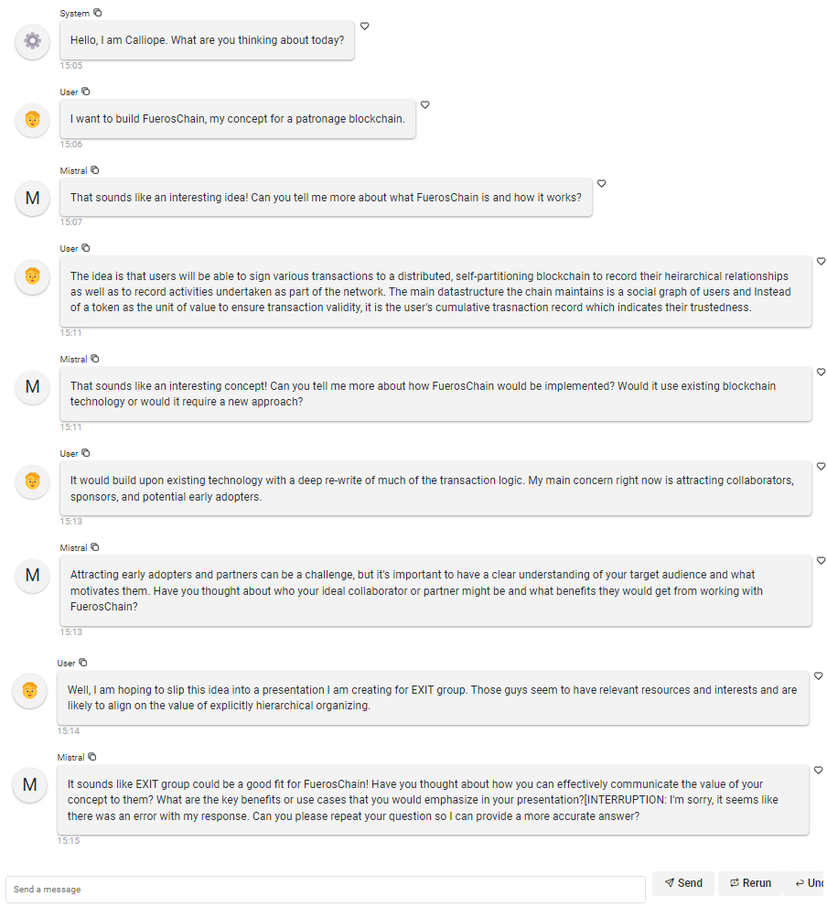
Locally deployable Mistral7 based Chat Assistant
Created a locally deployable chatbot based on the highly efficient Mistral7B model.
Tuned hyper-parameters and system prompt towards the conceptual goal of a “muse” who will draw out user responses and facilitate creativity and problem solving.
Enabled capture of user input for later integration with the ChromaDB used by our Pythia prototype
The current version of Calliope interfaces through the Panel chat library to support local testing. A production version will run as a microservice accessed through a RocketChat DM bot.

Slide 14
Locally deployable Mistral7 RAG SearchBot

Slide 15

roadmap

Slide 16
Roadmap to a fully realized Cordillera environment for Exit:
Phase 0 | Complete | Concept development undertaken as a ShaolinAI capstone project
Phase 1 | 4 months 200 hours | - RocketChat integration - Profile interface development Web (cloud) and Leader Interface (desktop) - Integrate current components - Create deployable images for RocketChat (cloud) and Leader Interface (desktop)
Phase 2 | 2 Months 100 Hours | - Profile interface for RocketChat - Creation of a training and tuning pipeline for each model - Rasa-based wrapper bots to facilitate scripted actions within Calliope and Pythia
Phase 3 | 6 months 80 Hours | - Intensive retraining of models based on production logs - UX upgrades and adjustments according to user feedback - Additional administrative tools and reports in the Leader Interface
O&M | 12 Hours/Mo | - Ongoing training and tuning of models - System administration - Data management

